Slide 1

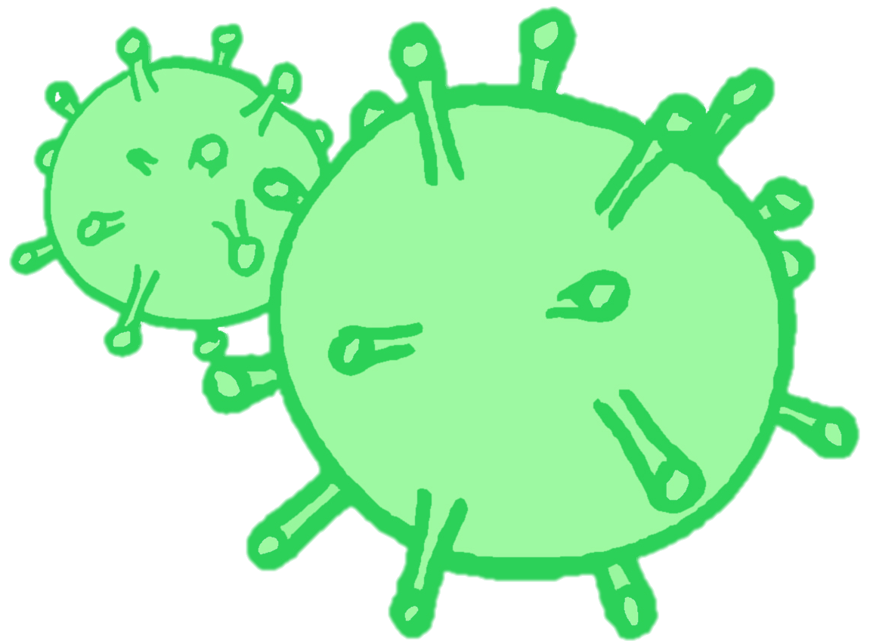
CONTRACEPTION & STI’s
Year 10 Health Lesson 6 Term 2, 2024

Slide 2

Today’s Focus
Consider your own values regarding your own sexual health.
Discuss barriers to getting tested
STI’s task – allocate groups and start working

Slide 3
Activity 1: values walk around
Placed around the room are response cards
Strongly Agree → Strongly Disagree
Your teacher will read out a statement and you need to decide how you feel about it and move to the card that best describes how you feel.
When doing this activity, really think about WHY you feel that way.
Be prepared to share your response and reasoning.
Notes:
Resources = Response cards (available in Health Storeroom) and blutack.
Place STRONGLY AGREE, AGREE, NEUTRAL, DISAGREE, STRONGLY DISAGREE cards around the room.
Read the statement out to students.
Give them 20 seconds to move to the card that best describes their response to the statement.
Ask students why they feel the way they feel.
This activity allows students to consider their values when it comes to relationships and sexual relationships.
You can use the statements on the following slides OR read them out from a piece of paper.

Slide 4
Values Statements:
It is mainly the boy's responsibility to buy condoms.
Teens who abstain from sex are less likely to be emotionally harmed.
Teens who abstain from sex are less likely to be physically harmed.
If you can’t talk with your partner about sex or contraception ahead of time, then you shouldn’t even consider having sex.
I would not buy condoms from a store where I might know someone.
Having sex without using contraception for the first one or two times is OK because the chances of getting pregnant are minimal.
Notes:
Read out the statement. Allow students 20 seconds to move to the appropriate card that describes their response. Encourage students to discuss and share their answers.

Slide 5
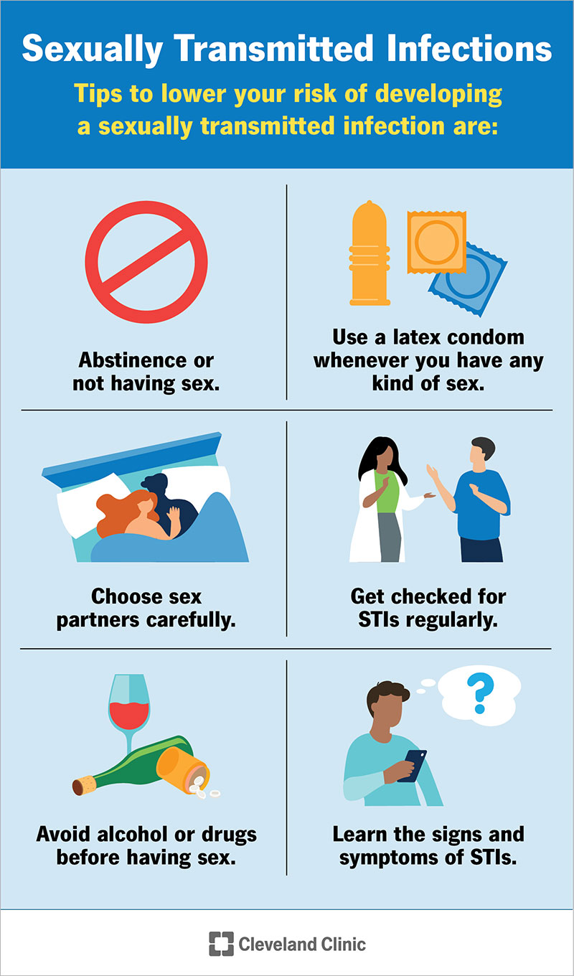
Prevention (pg. 21)
STI’s can only be 100% prevented by being abstinent (not engaging in sexual behaviours).
The only methods of contraception that protect against STI’s are condoms. But why?
Choose sexual partners wisely – the more sexual partners a person has, the higher the risk of contracting an STI.
Get tested regularly.
Avoid alcohol/drugs when engaging in sexual behaviours so you have a clear mind and can consider all associated risks, and don’t share needles.
Learn the signs/symptoms – this can help with early diagnosis and prevent further spread.
HPV and Hepatitis have effective vaccines available.
Notes:
Image is included in their books with space to complete the headings under neath each tip.

Slide 6
Diagnosis & TREATMENT (pg. 22)
A person should abstain from sexual behaviours if they believe they may have an STI, are currently being treated, or awaiting test results.
STI’s can be diagnosed through a variety of methods including:
Urine sample
Blood test
Swab test
The type of STI being tested for determines the diagnosis method used.
Treatment varies depending on the STI:
Viral – cannot be cured but medication may be available to treat the symptoms.
Bacterial – can be cured/treated with antibiotics.
Parasitic - through medication, creams, shampoos, lotions or ointments.
If diagnosed with an STI, it is important to inform your sexual partners.
www.letthemknow.org.au is an anonymous notification service.

Slide 7
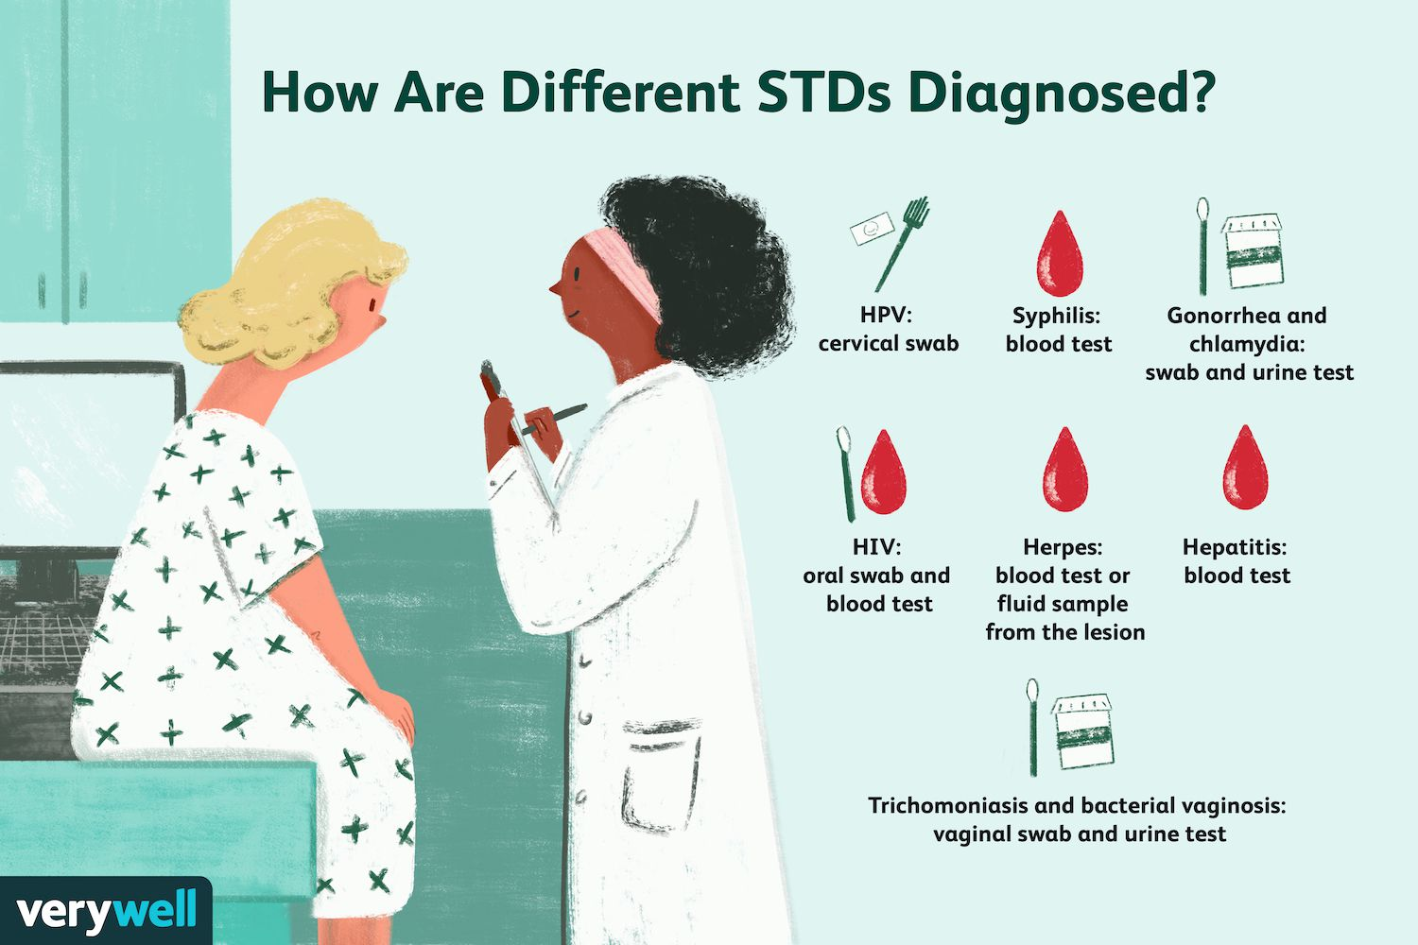
When should a person Get tested? (pg. 22)
Yearly, once becoming sexually active.
Have engaged in unprotected sexual intercourse or the condom broke.
Partner has an STI.
Partner is having sex with someone else.
Have ever injected drugs.
You or partner have any STI symptoms.
Have been a victim of sexual assault (i.e., rape).

Slide 8
Barriers to getting tested: (pg. 23)
Have a group discussion about what you believe would prevent/stop a person from getting tested for an STI.
You have 90 seconds to discuss.
Be prepared to share your thoughts.

Slide 9
Barriers to getting tested: (pg. 23)
Don’t know where to go for help or testing.
Costs time and money.
Inconvenient.
Perception that it ‘won’t happen to me’.
Fear of a positive result.
Lack of knowledge of signs/symptoms.
Associated stigma, embarrassment or shame.
Notes:
Students add these to their books.

Slide 10
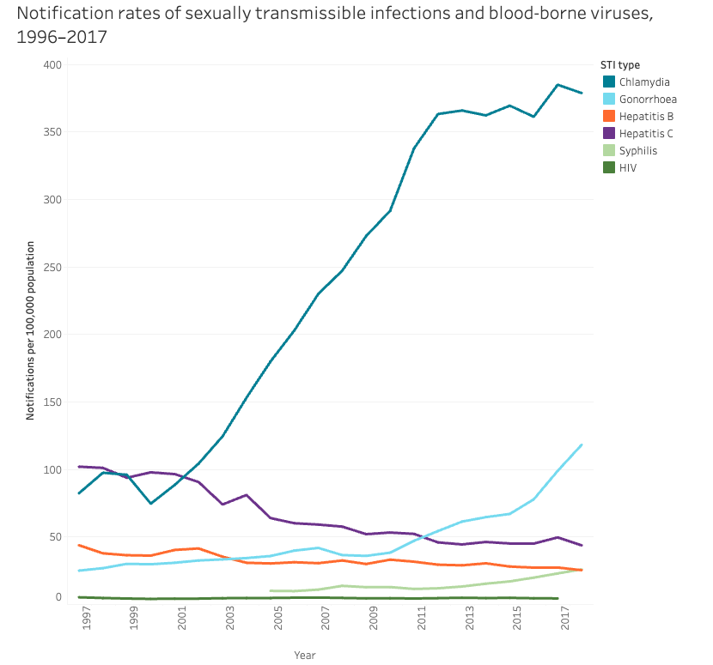
Big spike in no. of Chlamydia notifications from 1999 - 2017.
Steady decline of Hep C.
Hep B remains steady.
HIV has seen no notable increase <1997.
Spike in Gonorrhoea since 2009.
Spike in Syphilis from 2013.
What’s trending?
Notes:
Ask students what trends they can idenifty from the graph about STI rates from 1996-2017.

Slide 11
Statistics:
About 16% of Australians have had an STI in their lifetime.
In 2020, more than 29,000 Australians were living with HIV (an 18% drop of HIV notifications since 2015).
In 2020, there were about 57,500 new cases of notifiable STI among females and 67,400 among males
In Australia between approx. 2013-2023:
Gonorrhoea cases have doubled
Syphilis cases have more than tripled
Chlamydia cases have increased 12% since 2013
In Australia in 2022:
93,777 diagnoses of Chlamydia (still often undiagnosed)
most common STI, with more than 2 in 3 diagnoses occurring in 15-29 year-olds.
32,877 diagnoses of Gonorrhoea
6036 diagnoses of Syphilis
Notes:
https://www.kirby.unsw.edu.au/news/sexually-transmissible-infections-are-rise-australia-syphilis-rates-tripling-over-decade#:~:text=Early%20testing%2C%20diagnosis%2C%20and%20treatment,6%2C036%20diagnoses%20of%20infectious%20syphilis.

Slide 12
Assignments: Task 3 STI Oral Presentation (pg. 4-6)
You may work in groups of 2, 3 or 4 (max). Each group will be allocated a different STI to research and present on.
While groups are presenting, the audience will have a worksheet/table to fill out. By the end of all the presentations you will have a collection of information on all the different STI’s.
All assignments will be due by Week 9 (regardless of when you are presenting).
Each group member needs to talk during the presentation.
Four parts to the task: PowerPoint → Brochure → Presentation → Individual Group Reflection (all due week 9).

Slide 13

Presentation skills:
Q: What do you like and expect to see and experience when you are watching someone give a presentation?
Eye contact
Clearly spoken
Engaging tone of voice
Engaging content
Activities
Pictures and/or videos
Relevant information
Notes:
Ask students to contribute their answers.
Think about this when creating their own presentation and make it as engaging and entertaining as possible.

Slide 14
Presentation options:
You MUST have an oral presentation component in front of the class on the day and each group member is expected to speak.
What could you include in your presentation to make it engaging and entertaining?
How could you present your oral presentation?
Speech
Role Play
Rap or song
Videos
Etc.
Images and videos
Activities
Quizzes
Music
Etc.

Slide 15
STI’s:
Chlamydia
Syphilis
Gonorrhoea
Human Papilomavirus (HPV) / Genital Warts
Herpes Simplex Virus (HSV) & Genital Herpes
Scabies/Pubic Lice (crabs)
Trichomoniasis
Hepatitis A & B
HIV/AIDS
Notes:
Allocate one group to a different STI.
When students are presenting their assignments, the audience will need to complete a table about each different STI that is presented. By the end of the presentations, students will have collated information on all the different STI’s into their workbooks.

